Slide 1


PARENT NIGHT BASEBALL
2025-2026
WELCOME NEW AND RETURNING BARON BASEBALL FAMILIES!
Notes:
Falyn - Welcome/Opening - Introduce myself as the new Booster President

Slide 2

Agenda:
  A message from head coach Gerardo gonzalez
  Booster President Welcome
  booster board introductions
  rules & regulations
  program financial review
  fundraising
  How to connect with us
Notes:
Falyn cover agenda
Turn it over and introduce Head Varsity Coach Gerardo Gonzalez

Slide 3
head coach: Gerardo gonzalez
email: ggonzalez@hbuhsd.edu
  Coaching Staff Introductions
  Coaching Philosophy
  Core Values
  Vision for the Program
  Theme for the Season - With a Purpose
  Practice Policies & Expectations
  Playing Time / Team Assignments
  Good Conduct / Eligibility Policies
Notes:
Coach G

Slide 4
head coach: Gerardo gonzalez
“High school athletic programs exist to give our youth a safe, social outlet to exercise their bodies in addition to their minds. High school sports serve as the classroom where our athletes learn more about themselves, about competition, and that life isn’t fair at times. High school sports should teach us that hard work pays off, that the team is more important than the individual, and that it is possible to both win and lose with class, dignity and respect. These are life lessons that are very much needed to be a well-adjusted and successful adult.”
Notes:
Coach G

Slide 5
head coach: Gerardo gonzalez
Our objective & our purpose:
Our objective: is to win games. All our efforts on the field, weight room, cages, etc. is to enable us to be as competitive as possible. We are trying to win, but that is not our purpose.
Our Purpose: is to have a positive impact on the lives of our players. We want them to know these things as a result of playing baseball in our program.
Notes:
Coach G

Slide 6

head coach: Gerardo gonzalez
we want all our players to know:
their value is not defined by what they do on the baseball field
they have been supported by coaches and parents to make a positive impact in the world and they will always be part of the fv baseball program
they are cared about
Notes:
Coach G

Slide 7

Fvhs Capital campaign 2025-26
capital improvements
Our Mission:
To raise $300K
Field:
New artificial turf $230K
Outfield seeding $15K
New mower $10K
stadium:
New safety netting $10K
3rd visitor bleacher $25K
Outer stadium wrapping $10K
Notes:
Coach G/Tracy
Announcement of our goals for this fundraiser

Slide 8
falyn wilson
booster president
(949) 910-6168
info@fvhsbaronbaseball.com
Notes:
Coach G introduce Falyn

Slide 9
2025-2026 booster board
Falyn wilson, president
yasmina briceno, 1st vp
phill hewitt, snack bar
miki fujii, 2nd vp
jeremy kutsch, facilities
missy robinson, secretary
yasmina briceno, social/website
lynlee combs, treasurer
andi hill, event coordinator
tracy caballero, fundraising
jennifer cortez, event coordinator
jose grimaldo, merch/spiritwear
carrie farr, event coordinator
Notes:
Falyn
Fun Board Member Introductions

Slide 10

our objectives:
increase community awareness of the program
provide our coaches & players with the resources to maintain & updgrade our fields & facilities
support the baron baseball program financially
Notes:
Falyn

Slide 11
rules & regulations:
BUSINESS & PROFESSIONS CODE 25608
This law states you commit this crime if you possess, consume, sell,
distribute, or deliver any alcoholic beverage while on school grounds.
DRUG & TOBBACCO USAGE & POSSESSION
All public schools in California to prohibit the use of all drugs, drug paraphernalia and
tobacco products, including all electronic smoking devices, on all school property and in
all district vehicles at all times.
GUN FREE SCHOOL ZONE ACT
It is illegal for a person to have or use a gun in a school zone. A school zone is any area that is within 1,000 feet of a public or private school. This is a felony offence and the penalties for violating this law include a prison sentence up to 5 years.
Notes:
Falyn

Slide 12
Lynlee Combs
Treasurer

Slide 13
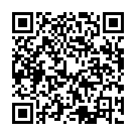
FINANCIAL REVIEW:
FVHS & HBUHSD PROVIDE ZERO FUNDING TO OUR PROGRAM
:pay here!
2025-2026 OVERALL BUDGET: $198,000
OVERALL COST PER PLAYER: $3,300
2025-26 BARON BASEBALL FEE: $1,800
Notes:
Lynlee

Slide 14
BREAKDOWN OF DONATIONS:
FALL DONATION #1: September 15TH $1,000
FALL DONATION #2: NOVEMBER 15TH $500
LEAGUE DONATION fINAL: January 15TH $300
Total: $1,800
IF ALL DONATIONS PAID BY SEPTEMBER 20TH = $1,650
ALL DONATIONS/RAISED OVER $1,800 CAN BE ROLLED OVER TO NEXT YEAR UP TO SENIOR YEAR
Donations are non-refundable
Notes:
Lynlee

Slide 15
$1,800 you say?
Ways to earn for your player
Baron event | player account credit
bingo | $60 per shift
program adverts | 75% of sales
banners | 75% of sales
cornhole sponsorship | 75% of sales
corporate donation | 75% of donation
sees candy | 100% of sales
Double Good Popcorn | 25% of Sales
*Any of the above fundraisers that earn player account credit can only be applied to annual player donations.
*The term “sales” is the dollar amount after the vendor has subtracted their costs and outlay
Notes:
Lynlee

Slide 16
WHERE DO YOUR DONATIONS GO?
Umpire fees for spring
Balls for the season
Equipment-Pitching machine,
L-screens, nettings
Field Supplies-racks, brooms,
drags, etc
Field Maintenance $20,000 p/year
Facility repairs or improvements
Stipends for Coaches fall & spring
Any fundraising expenses
Yearbook program
End of the year banquet
Credit card & Bank fees
Senior player scholarships
Replacement infield dirt, clay,
conditioner
CA Annual non-profit
application fee
Spirt wear
Opening Day
Snack Bar
Program insurance
...AND SO MUCH MORE!
Notes:
Lynlee & G

Slide 17
UNIFORMS/GEAR:
ALL PLAYERS RECEIVE THE FOLLOWING INCLUDED IN DONATION:
GAME DAY JERSEY & BASEBALL PANTS
Practice SHORTS
(2) DRI-FIT PRACTICE SHIRTS
HOODIE/WARM UP ITEM
BASEBALL HAT
FRESHMAN: ONE TIME PAYMENT $100
-BARON BASEBALL BAG, GAME DAY JERSEY & socks
jUNIOR VARSITY: Socks
VARSITY: Socks
Notes:
Coach G
Turn it over to Yas

Slide 18
REQUIRED BY FVHS:
THESE TWO COSTS ARE REQUIRED BY FVHS AND ARE SEPARATE FROM BOOSTER REQUESTS
ATHLETIC TRAINER DONATION: $20 (2025-26)
THIS PERSON IS ON-SITE FOR EVERY SPORT AND WILL WORK WITH ATHLETES MEDICALLY
tRANSPORTATION: $50
For each away game athletes at the Frosh and JV level
have to take school transportation. Athletes can
not travel via alternative methods.
Notes:
Yas
Refer to handout with screenshots with instructions on how to purchase each of these items

Slide 19
volunteer hours:
we kindly ask that each player family donate minimum of 15 hours
what qualifies:
  Field Day
  cornhole tournament
  work on program sales and any fundraiser
  stadium cleanup both frosh & varsity fields
  maintenance projects
  snack bar (min. requirement & will be assigned if not filled)
  FV Tree LIghting
Notes:
Yas
Turn it over to Tracy - Fundraising

Slide 20
tracy caballero fundraising

Slide 21
baron events calendar:
baron event | date
mandatory parent meeting | august 20th
cornhole tournament | october 11th
dine out fundraiser | monthly/bi-monthly
see’s candy fundraiser | Winter 9/1-11/30
Christmas FV Tree Lighting | December
Opening Day/Senior Day/Ball Drop | January 31st
Poker Night | February
Double Good Popcorn & Sees Candy | Spring
Comedy Night | March
Banquet | May
Notes:
Tracy
Subject to change

Slide 22
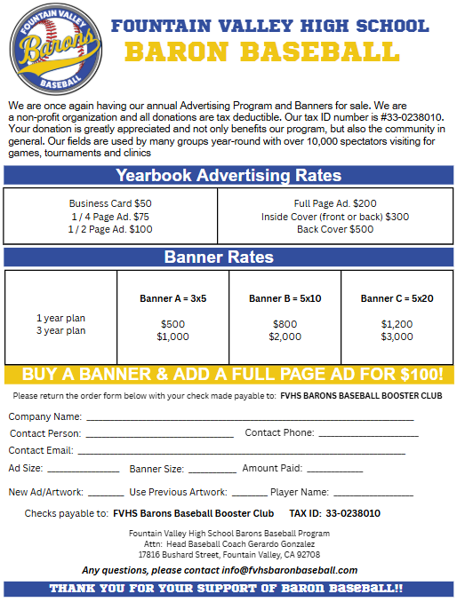
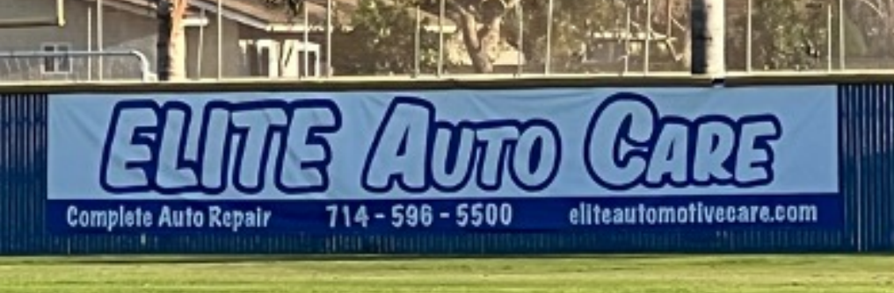
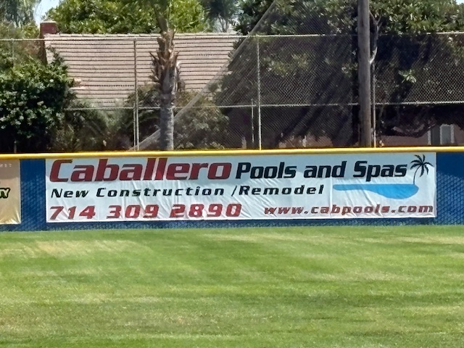
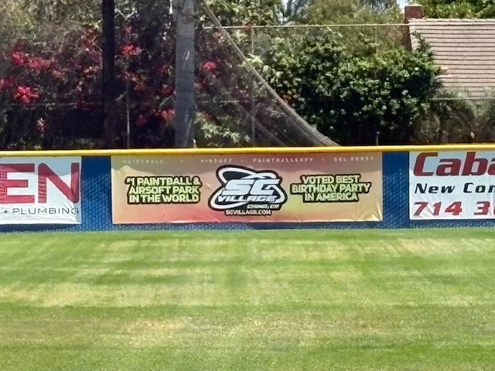
Adverts & banners:
Notes:
Tracy

Slide 23
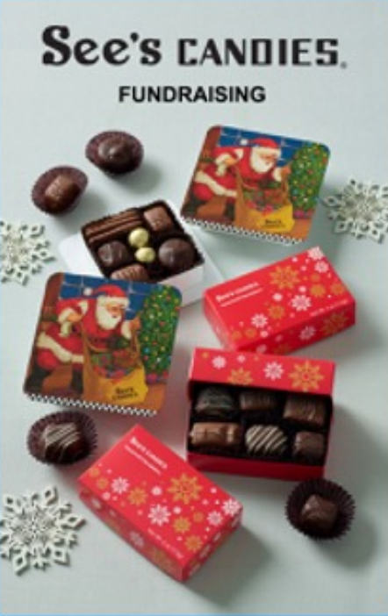

Sees candy fundraiser
9/1 – 11/30
request personal online store link
  Email: t3caballero@gmail.com
order form in parent packet
Fall/Winter 2025
Notes:
Tracy

Slide 24
DINE OUT FUNDRAISERS
CHIPOTLE
ISLANDS
CA FISH GRILL
PANDA EXPRESS
SAVE THE DATE!
9/10
10/14
10/29
11/12
Notes:
Tracy

Slide 25


Cornhole fundraiser – 10/11/25!
Registration open!
Each player must sell 2 tickets!
Notes:
Tracy & Yas
-We need sponsors
-We need donations (weekend getaways in demand!)
-We need volunteers
-We need to recruit players to join us! Friends, family and the community!

Slide 26

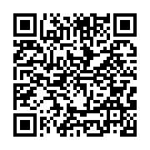
Opening day – 1/31/26!
Superbowl squares fundraiser on-site (New this year!)
Each player must sell 10 balls
:ball drop sales here!
Notes:
Tracy

Slide 27
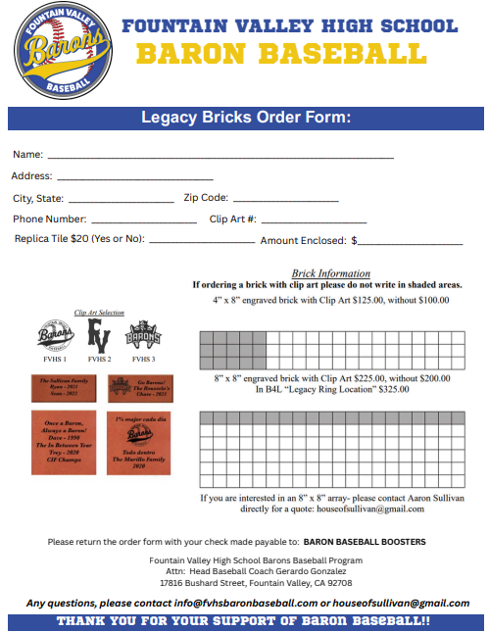

Legacy Bricks 2025/26
First order date prior to opening day: December 1st
Second order date Spring 2026
Notes:
Tracy
Begins now through December 1st
Link to order: https://polarengraving.com/fvhsbaronbaseball
*Working with Polar Engraving to update our fundraising site – more to come on this!

Slide 28
Phill Hewitt
Snack Bar

Slide 29
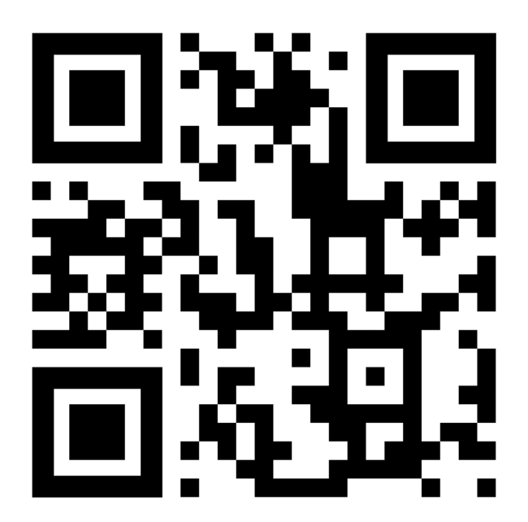
Snack bar shifts:
Important that all jv and varsity families sign up for shifts!
:sign up here!
Volunteer hours will count towards the 15-hour minimum requirement
Buy out option: we are exploring this as an option but as of right now we are asking all families to sign up to help!
Notes:
Falyn or Yas on behalf of Phill
We have our fall/winter games loaded and ready for volunteers to sign up!

Slide 30
Angie Diaz
bingo rep.

Slide 31

  Each shift you work, you will credit your players account with $60.00.
  Once you sign up, the shift will be considered filled, and you are locked into that slot.
  Please understand that you must show up for your shift, or you will be CHARGED $60 for a no-show.
  You may have a family member or friend cover for you, just tell them to check in under your name.
  On each Monday prior to your scheduled shift, you will receive an e-mail reminder.
  Volunteers must be over 18 years old and no longer a student at FVHS to help.
sign up tonight!
Questions? Contact Angie Diaz, Bingo Rep
Notes:
Angie

Slide 32
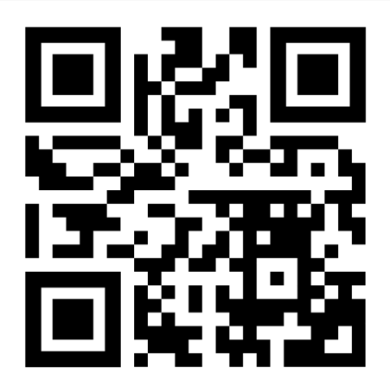
bingo signup:
no more mandatory 3 bingo shifts donated to the program
:sign up here!
all bingo shifts you sign up for and fulfill will be credited $60 to your player account
example: If you work 5 shifts (3 hours each) through the school year, you will raise $300 for your yearly donation.
no show costs us $60 which we will pass on the cost to you by charging your player account
Notes:
Angie
Turn it over to Jose Grim for Spiritwear and Merch

Slide 33
Jose grimaldo
spiritwear/merch.

Slide 34

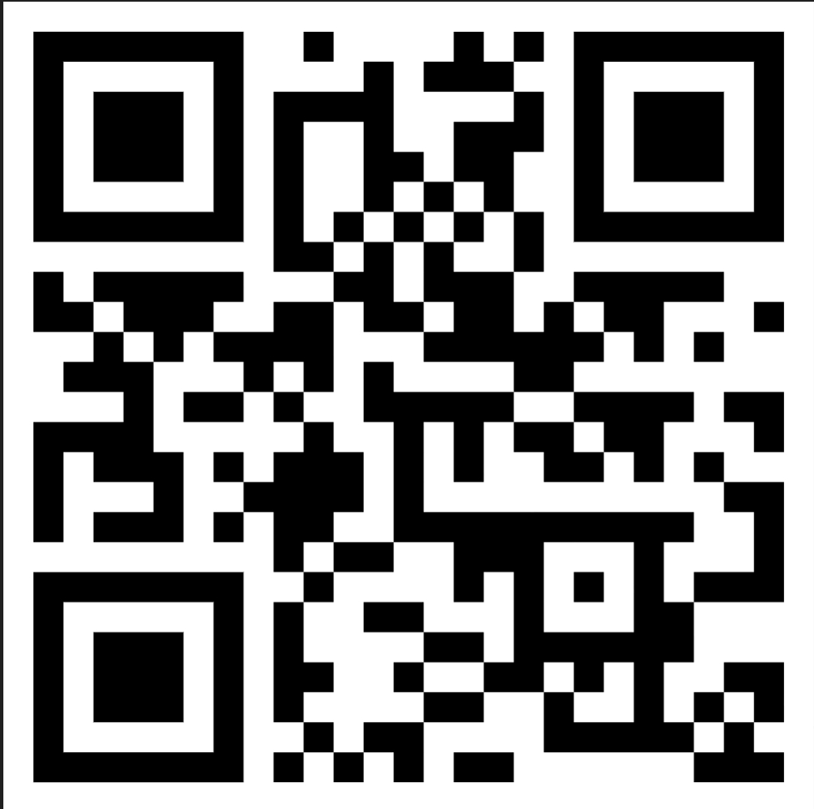
Merch for sale!
:purchase here!
Notes:
Jose Grimaldo
-What we have for sale tonight!
-Online Store – QR code on slide!
Turn it over to Coach G for facilities

Slide 35
Jeremy Kutsch
facilities
Notes:
Jeremy unable to attend parent meeting
G speak on behalf of our wish list and upcoming Field Day

Slide 36
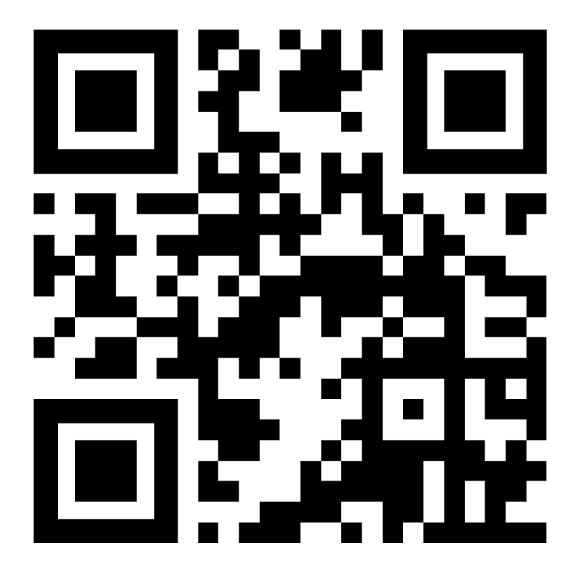
Facilities upgrades
Save the date: field day!
Painting, painting and more painting!
Facia
Dugout
Snack Bar
Power Washing
:sign up here!
10/25 & 10/26
Counts towards your volunteer hours requirement!
Notes:
Jeremy/Coach G
Turn it over to Yas for misc. update & how to connect with us

Slide 37
Yas Briceno
1st VP/Social Media

Slide 38




How to connect with us:
info@fvhsbaronbaseball.com
fvhsbaronbaseball
fvhsbaronbaseball
Linktree
Notes:
Yas
*Linktree houses all of our important links in one spot – can be accessed from our website as well. The QR code to our Linktree is on the important links document in your parent packets.

Slide 39
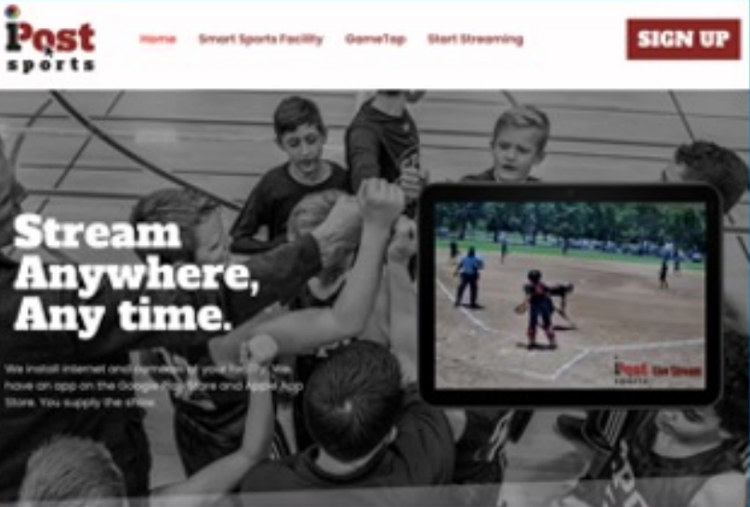
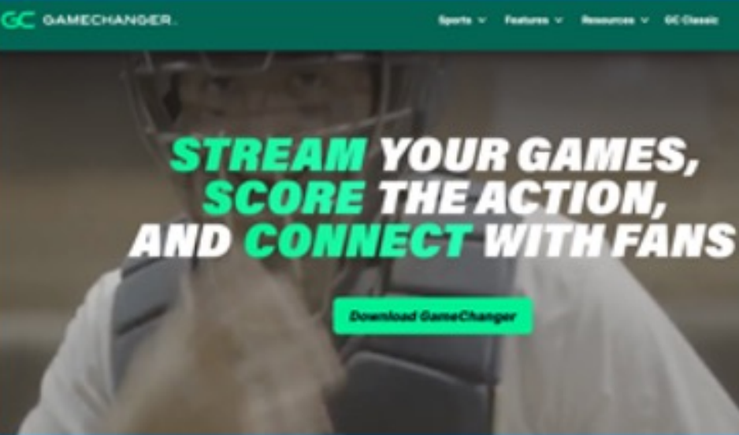
Live game coverage:
Ipost sports – field cameras
Subscription based
Game changer – community pass – (spring season only)
Access to player Stats & spray charts
Team parent will purchase the team subscription and divide amongst team
Notes:
Yas

Slide 40
thank you!

